Slide 1
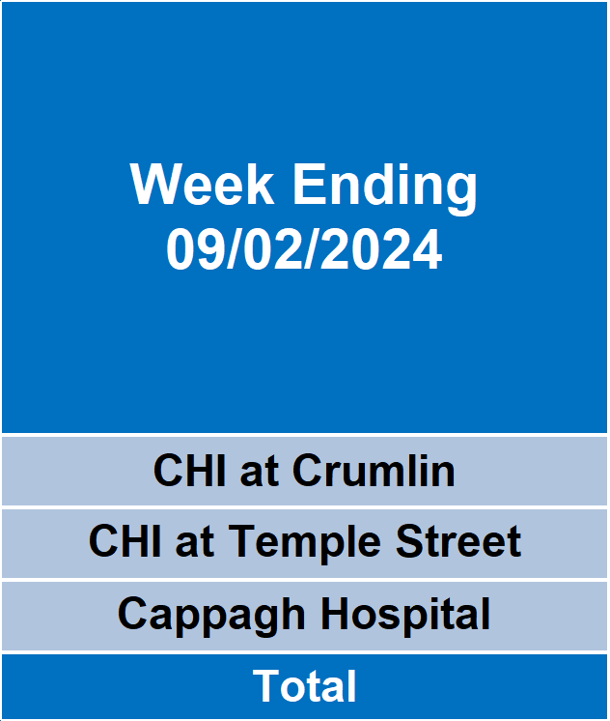
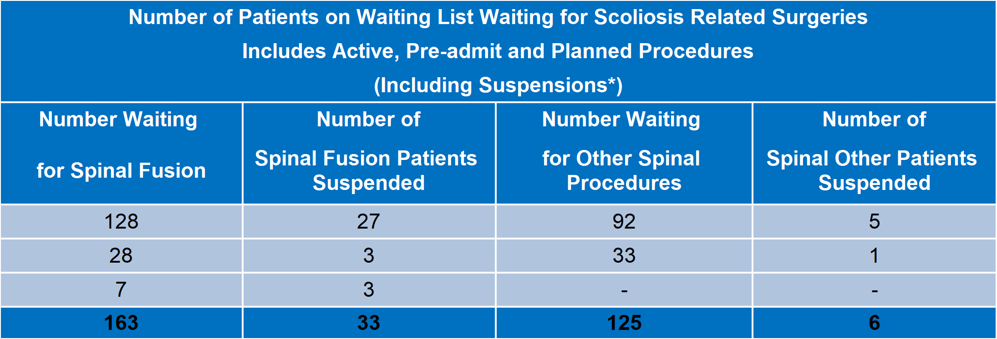
Children’s Health Ireland (CHI)
Update on Scoliosis Related Surgeries
Published on 12 February 2024
Total Surgeries (Including Single and Multiple Stages) Performed as of 9 February 2024
Total Number of Patients on Waiting Lists Clinically Deemed as Requiring Surgery as of 9 February 2024
*No of patients suspended from the waiting list, as patient is temporarily unavailable, clinically unsuitable or has a provisional date for outsourcing for their procedure. This includes all suspensions (hospital or patient initiated)

