Slide 1
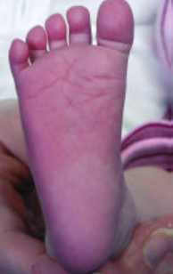
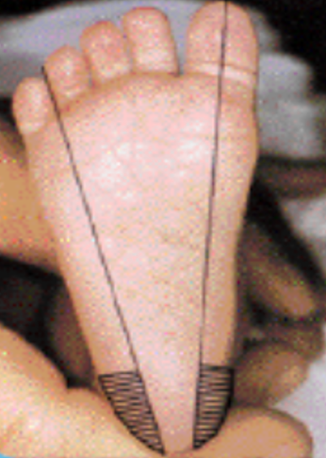
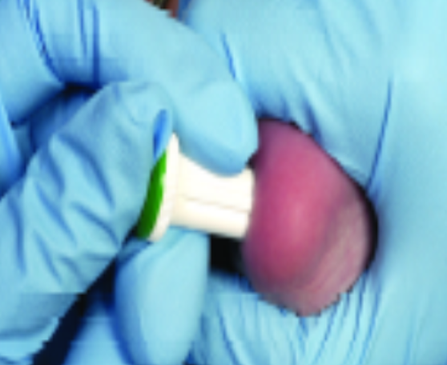
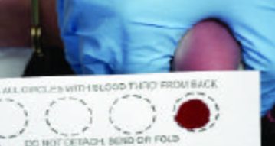
Newborn Screening
What is a Newborn Screen?
The NBS, also known as the heel prick, is performed on all babies born in Ireland to detect rare congenital and inherited conditions.
It is carried out before the onset of any clinical manifestations. This enables the early introduction of treatment leading to better clinical outcomes; avoiding significant morbidity and early premature mortality. If the baby tests positive for one of these conditions, early treatment can improve their long-term health and prevent disability. It can even prevent death.
How to do the NBS
Select the puncture site
Recommended site is the lateral borders of the plantar of the foot
Warm the site prior to sampling by rubbing the skin for 1-2 mins
Do not separate the baby from their parent. If baby is breastfed allow the mother to feed during the procedure. This is proven to reduce pain felt.
Cleanse the heel with warm soapy water and dry (Water, alcohol, milk, faeces or hand creams may effect results)
Puncture the heel with the lancet.
Allow a large blood drop to form
Touch the circle marked on the card gently to the hanging drop of blood so that blood soaks through from back to front.
PKU (phenylketonuria)
CHT (congenital hypothyroidism)
CGAL (classical galactosaemia)
GA 1 (glutaric aciduria type 1)
HCU (homocystinuria)
MSUD (maple syrup urine disease)
CF (cystic fibrosis)
MCADD (medium chain acyl CoA dehydrogenase deficiency)
Most of these conditions are inherited
Why Test?
Examples of samples taken
 | Valid Sample | Sufficient amount of blood to soak through to completely fill all circles
 | Insufficient Sample | Insufficient amount of blood to soak through to completely fill all circles
 | Sample not dry | Sample must be air dried – min 2 hours
 | Sample Oversaturated | Applying excess blood to card or to both sides of the card
 | Sample appears diluted / contaminated | Excess squeezing / contact with alcohol/milk / handcream either before or after collection. Excess heat
 | Serum rings | Excess squeezing / alcohol / incorrect drying
If the baby is in hospital, the nurses on the ward perform the test when the baby is 72-120 hours old. If a baby is going to theatre before 72 hours an additional NBS must be performed, this is called a Beutler.
For accurate results, the screen requires the baby to have reached 100mls/kg of enteral feeds. Otherwise, repeat screening is performed until this volume is reached.
Who & When?
Information leaflet given to parents
Consent – card must be signed
Correct Patient Information/DOB. Time of Birth. etc
Correct timing 72-120 hours of life
Has the baby received a RCC transfusion? Please document
Correct neonatal lancet (pink and blue)
Correct site
Ensure baby’s foot is warm (to enhance blood flow)
Correct Maternity Hospital Number (found on transfer letter)
UPI number (hospital identifier) found on NBS box locally
Gauze and plaster.
Checklist for NBS
The NBS must be completed between 72 -120 hours of age
To ensure accuracy, babies that are NPO or taking < 100mls/kg/day of enteral feeds will require repeat screening. This must be repeated weekly until the baby is taking >100mls/kg/day of enteral feeds. Example: babies on TPN, post surgery.
A maximum of 4 samples will be sent and then a final sample when the baby reaches >100mls/kg/day or ‘full feeds’ of enteral feeds.
If a baby is transferred or discharged, it is important that the relevant people are informed if a repeat is necessary.
Repeats
While the baby is in hospital, the results are followed up by the Neonatal team. The results if any will be relayed by the medical team to the family and acted on accordingly.
In the community, if the family are not contacted by Temple Street the findings are considered to be normal.
Please contact the Neonatal CNSp bleep 8603 for any queries.
Results

